Slide 1
PURITY TEST OF SUGAR OF MILK
Prepared By
Dr.SREEJA.S
Prof & Head, Dept of Pharmacy

Slide 2
SUGAR OF MILK
It is a solid vehicle used in Homoeopathy for preparation and dispensing of medicine.
Prepared from Goats milk
Physical Properties –
Colour ( Milky White )
Taste - Faintly Sweet
Odour – Odourless
Consistensy – Sandy, Gritty, Rough to feel

Slide 3
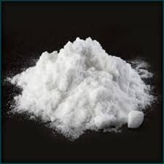
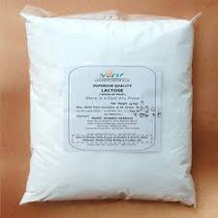
SUGAR OF MILK

Slide 4
CHEMICAL TEST
Litmus Test - Prepare an aqueous solution of sugar of milk by putting small quantity of sugar of milk in a test tube and pouring distilled water into it and dissolve the powder by shaking the test tube.
Dip blue litmus paper into the solution.
Positive test for acid – Blue litmus paper changes into red
Negative test for acid – Blue litmus paper retains its blue colour

Slide 5
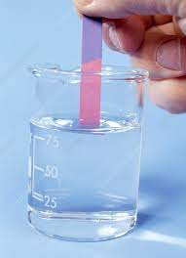
LITMUS TEST

Slide 6
TEST FOR STARCH(Iodine test)
EXPERIMENT | OBSERVATION | INFERENCE
Take a test tube and pour 2 -3 ml of aqueous solution of sugar of milk and using a dropping pipette pour one or two drops of IODINE Solution into it | Solution changes into blue colour | Presence of STARCH
Take a test tube and pour 2 -3 ml of aqueous solution of sugar of milk and using a dropping pippette pour one or two drops of IODINE Solution into it | Colour of the Solution remains same | Absence of STARCH

Slide 7
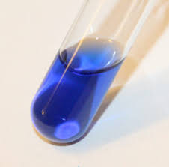
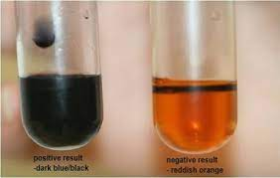
TEST FOR STARCH(Iodine test)
Presence of Starch
Absence of Starch

Slide 8
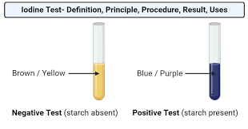
TEST FOR STARCH(Iodine test)

Slide 9
TEST FOR ALUM
EXPERIMENT | OBSERVATION | INFERENCE
Take a test tube and pour 2 -3 ml of aqueous solution of sugar of milk and pour few drops of sodium hydroxide into it | A WHITE PRECIPITATE is formed | Presence of ALUM
Take a test tube and pour 2 -3 ml of aqueous solution of sugar of milk and pour few drops of sodium hydroxide into it | NO WHITE PRECIPITATE is formed | Absence of ALUM

Slide 10
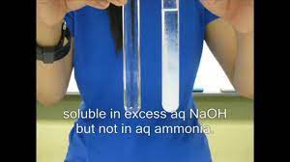
TEST FOR ALUM

Slide 11
TEST FOR COPPER
EXPERIMENT | OBSERVATION | INFERENCE
Take a test tube and pour 2 -3 ml of aqueous solution of sugar of milk and pour few drops of Potassium ferrocyanide solution into it | A REDDISH – BROWN PRECIPITATE is formed | Presence of COPPER
Take a test tube and pour 2 -3 ml of aqueous solution of sugar of milk and pour few drops of Potassium ferrocyanide solution into it | NO REDDISH – BROWN PRECIPITATE is formed | Absence of COPPER

Slide 12
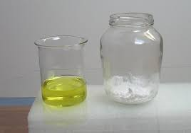
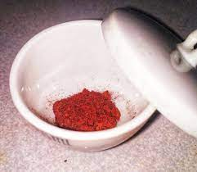
TEST FOR COPPER
Potassium ferrocyanide Solution
Reddish Brown Sediment

Slide 13
TEST FOR CHLORIDE
EXPERIMENT | OBSERVATION | INFERENCE
Take a test tube and pour 2 -3 ml of aqueous solution of sugar of milk and pour few drops of Silver nitrate solution into it | A WHITE PRECIPITATE is formed | Presence of CHLORIDE
Take a test tube and pour 2 -3 ml of aqueous solution of sugar of milk and pour few drops of Potassium ferrocyanide into it | NO WHITE PRECIPITATE is formed | Absence of CHLORIDE

Slide 14
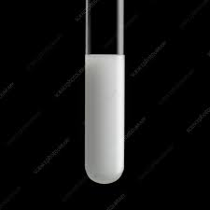
TEST FOR CHLORIDE

Slide 15
TEST FOR PHOSPHATE
EXPERIMENT | OBSERVATION | INFERENCE
Take a test tube and pour 2 -3 ml of aqueous solution of sugar of milk and pour few drops of Silver nitrate solution into it | A YELLOW PRECIPITATE is formed | Presence of PHOSPHATE
Take a test tube and pour 2 -3 ml of aqueous solution of sugar of milk and pour few drops of Silver nitrate solution into it | NO YELLOW PRECIPITATE is formed | Absence of PHOSPHATE

Slide 16
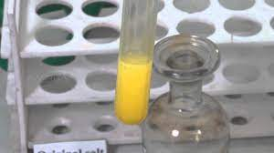
TEST FOR PHOSPHATE

